Slide 1
K-means clustering
CH-V
Dr Shola Usharani

Slide 2
Steps for clustering
Initialize the clusters and number of iterations
Finding the distances
For each iteration starting from 0
Calculate the distance of each point with clusterheads
Find the min distance cluster
Assign the point into that cluster
Assign the cluster with cluster index
Recalculate the new cetroids
Generate cluster groups and assignment groups for points

Slide 3
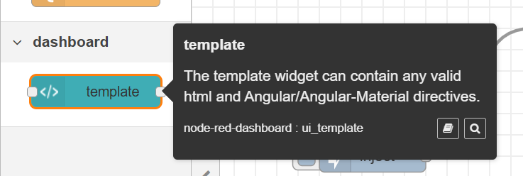
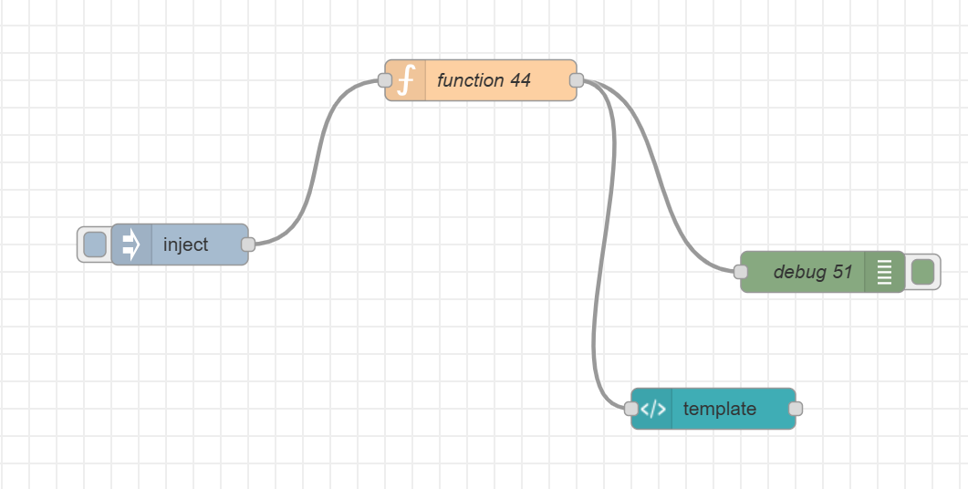
Flow to develop

Slide 4
Consider a sample dataset that have 8 data points representing temperature and humidity readings from environmental sensors. Perform K-means clustering algorithm for the given data set using Absolute Distance. Display the sample out put in node red browser as 2d- chart. Consider there are three clusters for the given dataset.
Temperature (°C) | Humidity (%) | Cluster
22 | 60
20 | 55
25 | 65
18 | 50
30 | 70
21 | 58
23 | 62
26 | 68

